Slide 1
SLEEP APNEA DETECTION FOR INFANTS
PROJECT GUIDE
Dr.A.Hemlathadhevi,M.E,Ph.D
PROJECT COORDINATOR
Dr.V.Valarmathi,M.E,Ph.D
TEAM MEMBERS
SRI JANANI A
SRI VARSHAA N

Slide 2
Objective
The objective is to detect Sleep Apnea Detection From Single-Lead ECG.
The advancement of technologies has provided a unique opportunity for sleep and health monitoring.

Slide 3
Abstract
It presents a fully integrated system for the detection and prevention of sleep apnea in infants.
This will be a solution for both monitoring and preventing the condition using accurate readings and also judging and giving suggestions on when the patient needs medical help using cloud.

Slide 4
Existing System
Technologies presented in recent literatures for apnea include monitoring the oxygen levels using sensors and, in some cases, include chest belt, straingauge, etc.
An algorithm used with the MAX30102 (For Spo2) output signal can make up for the error associated with Spo2 readings with ambient temperature changes.
This helps to notify the variations in the heart rate which is caused due to the variations in oxygen levels leading to complications.

Slide 5
Proposed System
This is a unbiased method that heplsconventional machine learning and deep learning algorithms in the detection of sleep apnea occurrence from a single-lead ECG.
All the experiments are performed on the same dataset and under the same setting to be able to properly evaluate the performances of different algorithms
Three sets of data are used, a training set to train the model parameters, a validation set to find the model optimum hyperparameters, and a test set to evaluate the generalizability of the developed models on unseen data.

Slide 6
Modules
Classification of Peaks
Feature Extraction Using Machine Learning
Detection Using Deep Learning

Slide 7
Classification of Peaks
PhysioNet Apnea-ECG Database was used to build our models and to compare their performances.
The database contains recordings divided into four groups: A, B, C, and X.
In this dataset AHI 5 and are categorized as normal, 13 individuals have AHI > 30, and are categorized in the severe sleep apnea class, and six individuals have 5 < AHI <30 and are categorized in the mild and moderate apnea class.
The annotation of the presence of sleep apnea is provided for every 1 min by a sleep expert.

Slide 8
Feature Extraction Using Machine Learning
ECG signals were segmented into 1-min intervals.
To extract the R–R Intervals from the ECG signal, the Hamilton Rpeak detection method based on an open-source code was employed.
A median filter proposed by Chen et al was used for removing physiologically uninterpretable points.
The extracted R–R Intervals were then presented to the developed machine learning algorithms after appropriate processing

Slide 9
Feature extraction, feature selection, and classification are the main steps in conventional machine learning methods.
ECG signals were pre-processed.
Then time, frequency, and nonlinear features of the ECG signal were extracted.
In addition to this, principal component analysis (PCA) was applied for the most effective and important features for classification

Slide 10
Detection Using Deep Learning
It was observed that deep learning models outperform conventional machine learning techniques.
Among deep learning algorithms, CNNbased models performed better than DRNNs in our application where short segments of ECG (1 min) were processed.
The best detection performances were obtained using hybrid CNNDRNN architectures among which ZFNet-BiLSTM achieved the highest accuracy and specificity and ZFNet-GRU achieved the best sensitivity

Slide 11
Hardware & Software Requirements
Hard Disk : 500GB and Above
RAM : 4GB and Above
Processor : I3 and Above
Webcam – 1
Operating System : Windows 10 (64 bit)
Software : Python
Tools : Anaconda

Slide 12
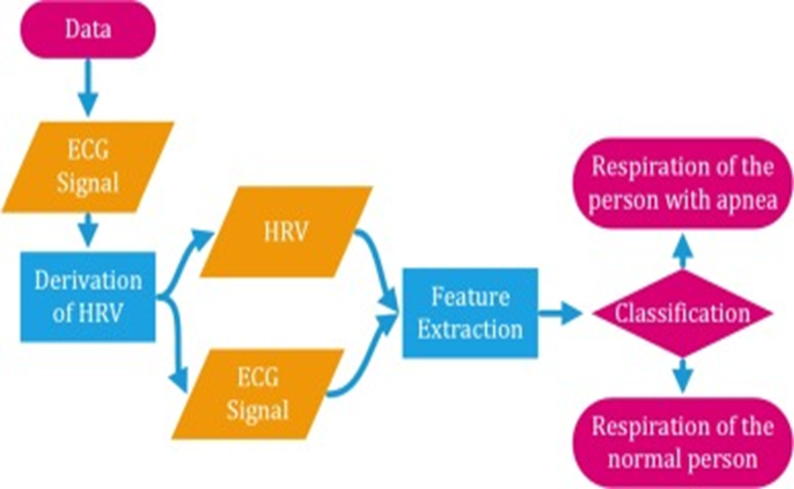
Architecture Diagram

Slide 13
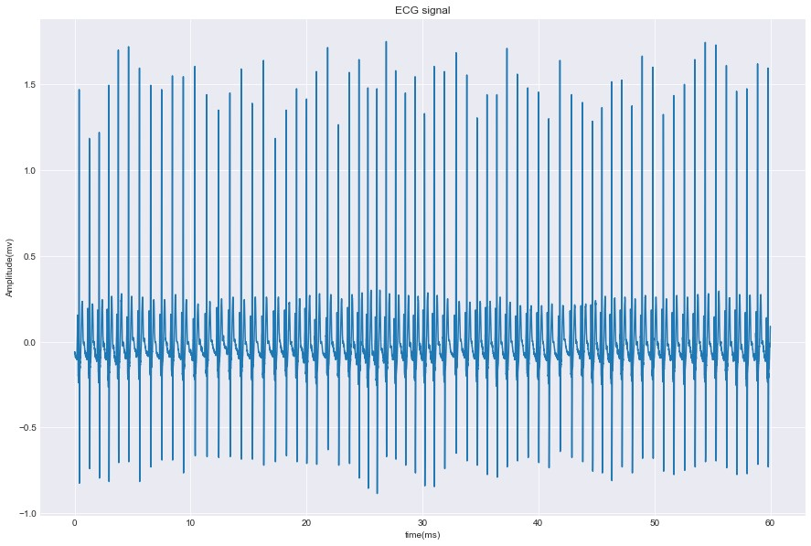
Sample Screenshots
Screenshot of Raw ECG Data

Slide 14
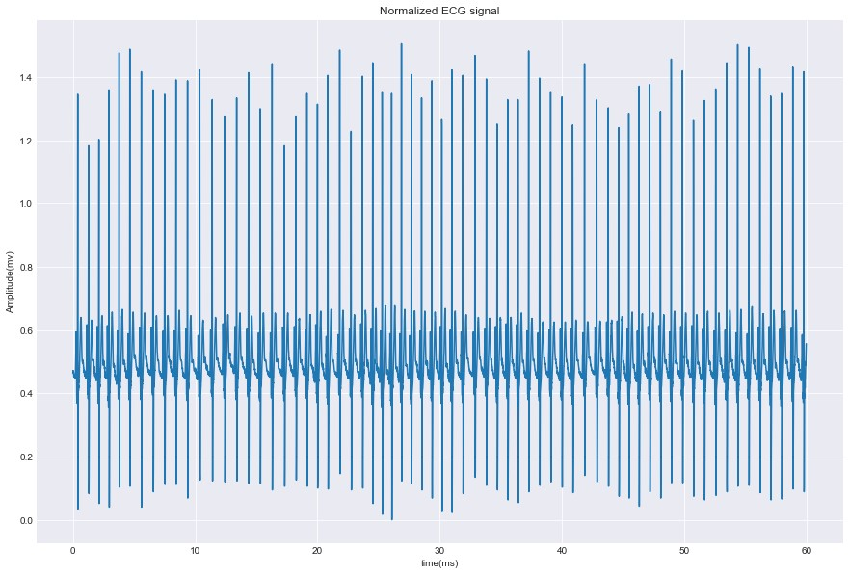
Screenshot of Normalized ECG Data

Slide 15
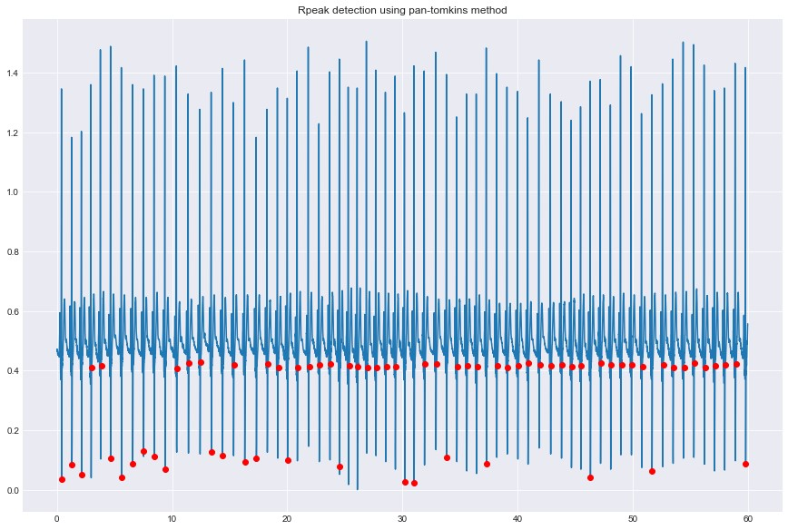
Screenshot of R-peak detection using Pan Tomkims method

Slide 16
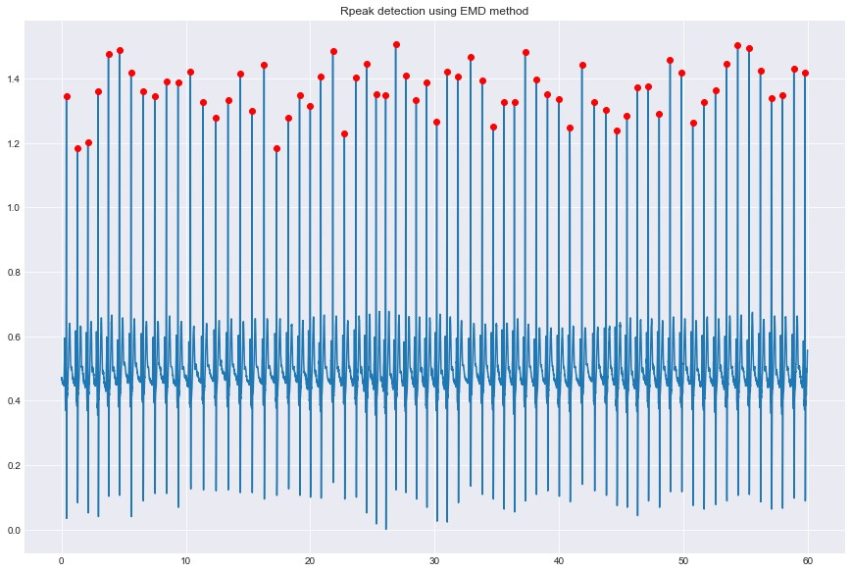
Screenshot of R-peak detection using EMD method

Slide 17
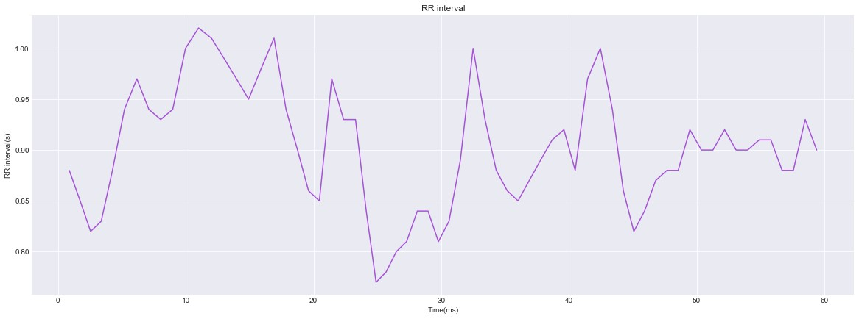
Screenshot of R-R Interval graph

Slide 18
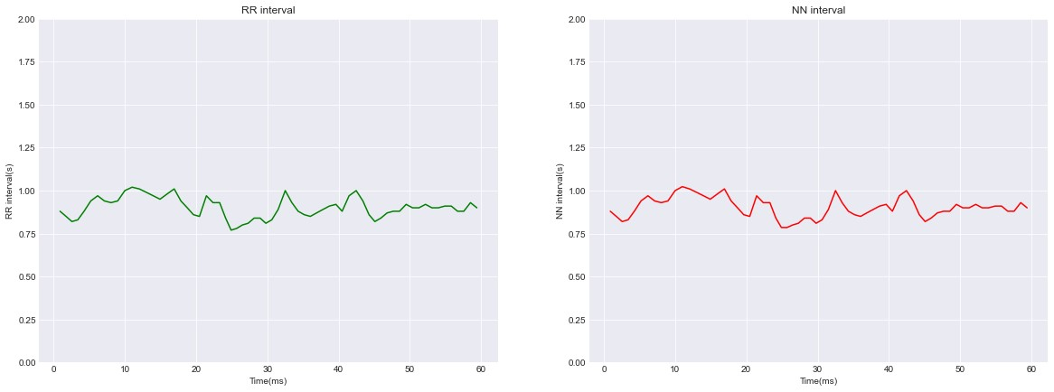
Screenshot of R-R Interval graph and N-N Interval graph

Slide 19
Conclusion
The best detection performances were obtained using hybrid CNNDRNN architectures among which VGG16 achieved the highest accuracy and specificity.
Based on the achieved results, the use of hybrid deep neural networks is recommended for sleep apnea detection from ECG.

Slide 20
Future Enhancements
Developing more sophisticated algorithms for feature extraction from single-lead ECG signals can enhance the accuracy of sleep apnea detection
This can involve extracting features related to heart rate variability, respiratory patterns, and presence of arrhythmias

Slide 21
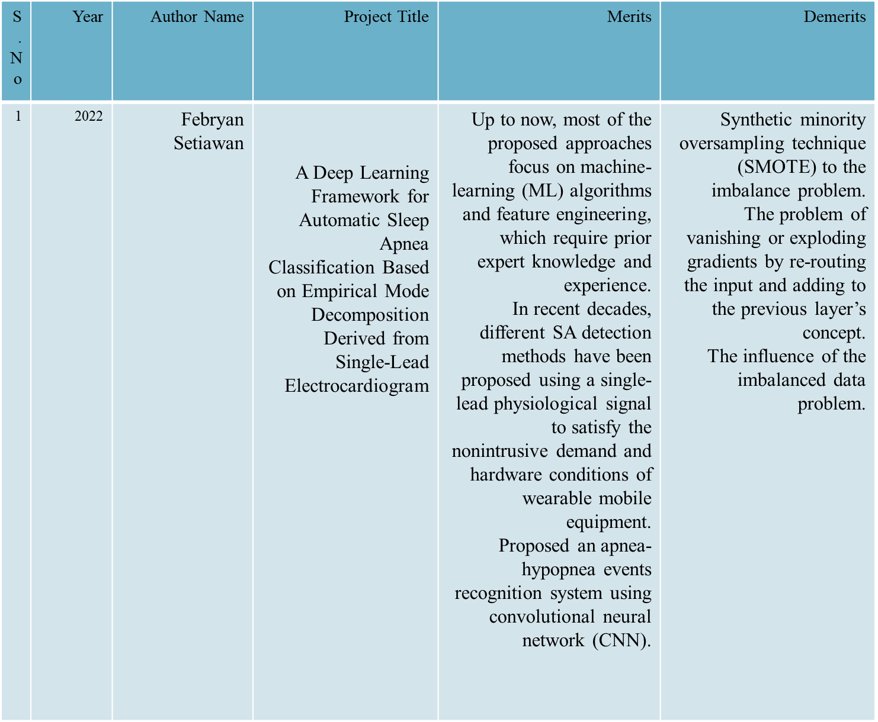
LITERARY SURVEY

Slide 22
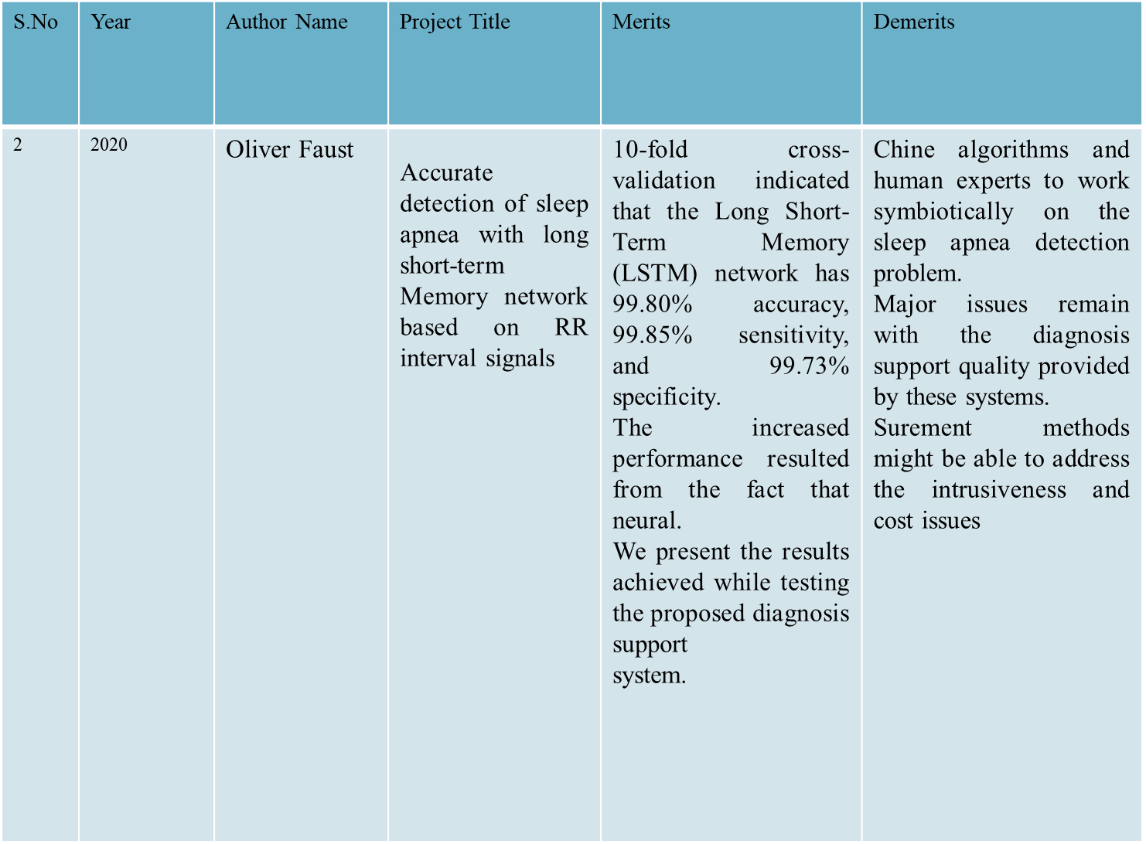

Slide 23
THANKYOU

